Slide 1


Slide 2
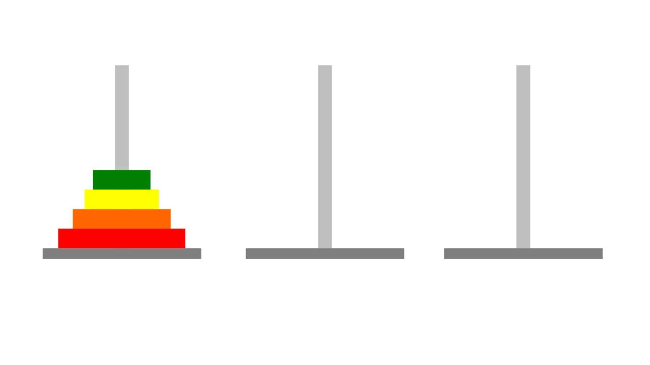
Torres de hanoi
Simulación

Slide 3
Torres de hanoi
n = 3
Move 1: move disk 2 to post B
Move 2: move disk 1 to post C
Move 3: move disk 2 to post C
Move 1: move disk 3 to post C
Move 2: move disk 2 to post B
Move 3: move disk 3 to post B
Move 4: move disk 1 to post C
Move 5: move disk 3 to post A
Move 6: move disk 2 to post C
Move 7: move disk 3 to post C
n = 2
http://mathforum.org/dr.math/faq/faq.tower.hanoi.html

Slide 4

Combinaciones y Permutaciones

Slide 5


Slide 6





Slide 7


<semillero>

Slide 8
Permutaciones de XYZ
COMPLETAR
P(“ ”,XYZ)
P(“ X”,YZ)
P(“ Y”,XZ)
P(“ Z”,XY)
P(“ XY”,Z)
P(“ XZ”,Y)
P(“ YX”,Z)
P(“ YZ”,X)
P(“ZX ”,Y)
P(“ZY ”,X)
XYZ
XZY
YXZ
YZX
ZXY
ZYX

